Slide 1


To - Do List Website
Eisenhower Matrix
TEAM 32

Slide 2
Why we chose this topic?
A Good learning opportunity in Web Development and Database Management Systems.
The Web Development Industry has been growing exponentially from the past decade. (Full - Stack Developers)
By the end of this we would have a working To-Do List that anyone can access. Start Simple when learning something new.

Slide 3
What are we using?
HTML and CSS for initial web page design.
Javascript for a Dynamic Website look.
JS Local storage for Back-End Development.

Slide 4
About Eisenhower Matrix
Tasks are segregated into four different quadrants. The 1st quadrant holds urgent and important tasks.
The 2nd quadrant holds important but not urgent tasks. The 3rd quadrant contains tasks that are not important but urgent.
The 4th quadrant contains tasks that are
neither urgent not important.

Slide 5
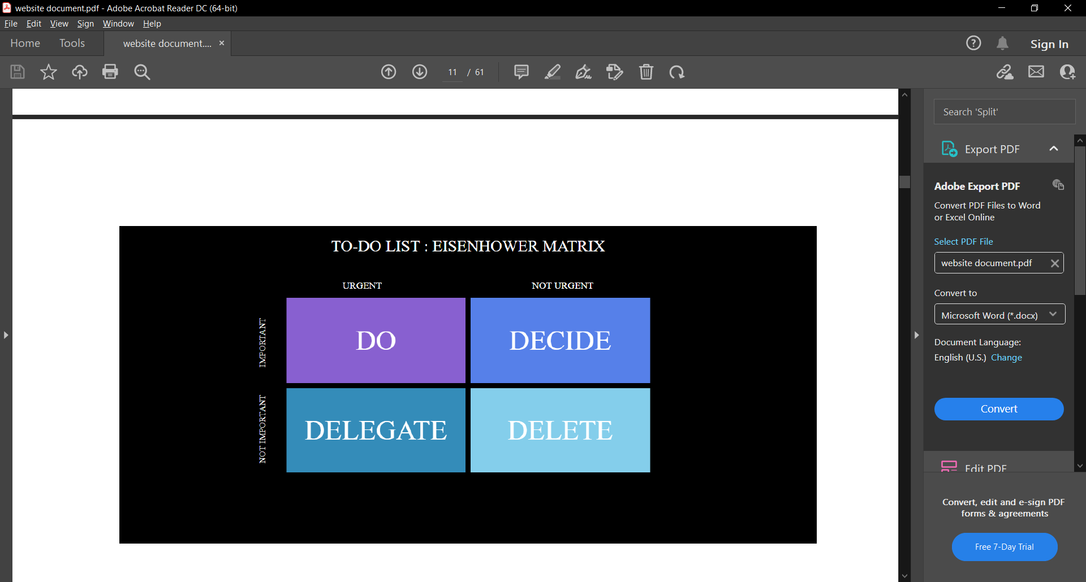
Eisenhower Matrix

Slide 6
Work Distribution
Initial Web page design and Home Page design, using HTML. (Keerthana BP and Rahul KC)
More Web pages design (about us, settings, etc) and hyperlinks. (Keerthana BP and Rahul KC)
Eisenhower Matrix front page complete(Sanath and Lochan)
Javascript to make the List part of website more responsive.(Sanath)
Local Storage of data in browser(Sanath).

Slide 7
THANK YOU
Team members -
BP Keerthana(1CR19IS062)
Lochan HN(1CR19IS073)
M Sanath(1CR19IS076)
Rahul KC(1CR19IS113)
Guide-
Akhila Ma’am

